Slide 1
Chapter 2
Lists and the Collections Framework

Slide 2
Chapter Objectives
The List interface
Writing an array-based implementation of List
Linked list data structures:
Singly-linked
Doubly-linked
Circular
Big-O notation and algorithm efficiency
Implementing the List interface as a linked list
The Iterator interface
Implementing Iterator for a linked list
Testing strategies
The Java Collections framework (hierarchy)

Slide 3
Introduction
A list is a collection of elements, each with a position or index
Iterators facilitate sequential access to lists
Classes ArrayList, Vector, and LinkedList are subclasses of abstract class AbstractList and implement the List interface

Slide 4
The List Interface and ArrayList Class
Section 2.1

Slide 5
List Interface and ArrayList Class
An array is an indexed structure
In an indexed structure,
elements may be accessed in any order using subscript values
elements can be accessed in sequence using a loop that increments the subscript
With the Java Array object, you cannot
increase or decrease its length (length is fixed)
add an element at a specified position without shifting elements to make room
remove an element at a specified position and keep the elements contiguous without shifting elements to fill in the gap

Slide 6
List Interface and ArrayList Class (cont.)
Java provides a List interface as part of its API java.util
Classes that implement the List interface provide the functionality of an indexed data structure and offer many more operations
A sample of the operations:
Obtain an element at a specified position
Replace an element at a specified position
Find a specified target value
Add an element at either end
Remove an element from either end
Insert or remove an element at any position
Traverse the list structure without managing a subscript
All classes introduced in this chapter support these operations, but they do not support them with the same degree of efficiency

Slide 7
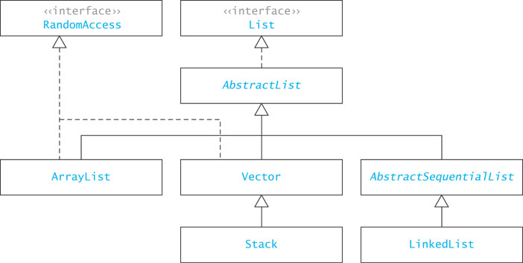
java.util.List Interface and its Implementers

Slide 8
List Interface and ArrayList Class
Unlike the Array data structure, classes that implement the List interface cannot store primitive types
Classes must store values as objects
This requires you to wrap primitive types, such as int and double in object wrappers, in these cases, Integer and Double

Slide 9
ArrayList Class
The simplest class that implements the List interface
An improvement over an array object
Use when:
you will be adding new elements to the end of a list
you need to access elements quickly in any order

Slide 10
ArrayList Class (cont.)
To declare a List “object” whose elements will reference String objects:
List<String> myList = new ArrayList<String>();
The initial List is empty and has a default initial capacity of 10 elements
To add strings to the list,
myList.add("Bashful");
myList.add("Awful");
myList.add("Jumpy");
myList.add("Happy");

Slide 11
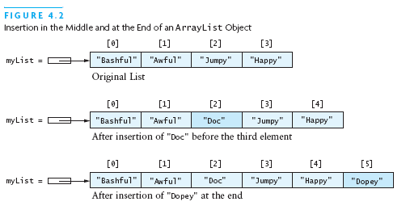
ArrayList Class (cont.)
Adding an element with subscript 2:
myList.add(2, "Doc");
Notice that the subscripts of "Jumpy" and "Happy" have changed from [2],[3] to [3],[4]

Slide 12
ArrayList Class (cont.)
When no subscript is specified, an element is added at the end of the list:
myList.add("Dopey");

Slide 13

ArrayList Class (cont.)
Removing an element:
myList.remove(1);
The strings referenced by [2] to [5] have changed to [1] to [4]

Slide 14

ArrayList Class (cont.)
You may also replace an element:
myList.set(2, "Sneezy");

Slide 15
ArrayList Class (cont.)
You cannot access an element using a bracket index as you can with arrays (array[1])
Instead, you must use the get() method:
String dwarf = myList.get(2);
The value of dwarf becomes "Sneezy"

Slide 16
ArrayList Class (cont.)
You can also search an ArrayList:
myList.indexOf("Sneezy");
This returns 2 while
myList.indexOf("Jumpy");
returns -1 which indicates an unsuccessful search

Slide 17
Generic Collections
The statement
List<String> myList = new ArrayList<String>();
uses a language feature called generic collections or generics
The statement creates a List of String; only references of type String can be stored in the list
String in this statement is called a type parameter
The type parameter sets the data type of all objects stored in a collection

Slide 18
Generic Collections (cont.)
The general declaration for generic collection is
CollectionClassName<E> variable = new CollectionClassName<E>();
The <E> indicates a type parameter
Adding a noncompatible type to a generic collection will generate an error during compile time
However, primitive types will be autoboxed:
ArrayList<Integer> myList = new ArrayList<Integer>();
myList.add(new Integer(3)); // ok
myList.add(3); // also ok! 3 is automatically wrapped
in an Integer object
myList.add(new String("Hello")); // generates a type incompatability error

Slide 19
Why Use Generic Collections?
Better type-checking: catch more errors, catch them earlier
Documents intent
Avoids the need to downcast from Object

Slide 20
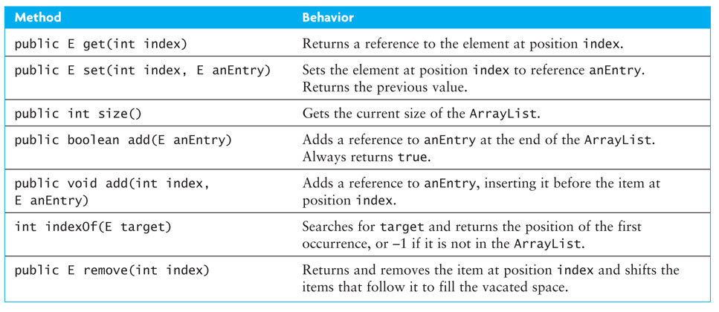
Specification of the ArrayList Class

Slide 21
Applications of ArrayList
Section 2.2

Slide 22
Example Application of ArrayList
ArrayList<Integer> someInts = new ArrayList<Integer>();
int[] nums = {5, 7, 2, 15};
for (int i = 0; i < nums.length; i++) {
someInts.add(nums[i]);
}
// Display the sum
int sum = 0;
for (int i = 0; i < someInts.size(); i++) {
sum += someInts.get(i);
}
System.out.println("sum is " + sum);

Slide 23
Example Application of ArrayList (cont.)
ArrayList<Integer> someInts = new ArrayList<Integer>();
int[] nums = {5, 7, 2, 15};
for (int i = 0; i < nums.length; i++) {
someInts.add(nums[i]);
}
// Display the sum
int sum = 0;
for (int i = 0; i < someInts.size(); i++) {
sum += someInts.get(i);
}
System.out.println("sum is " + sum);
nums[i] is an int; it is automatically wrapped in an Integer object

Slide 24
Phone Directory Application
public class DirectoryEntry {
String name;
String number;
}
Create a class for objects stored in the directory

Slide 25
Phone Directory Application (cont.)
public class DirectoryEntry {
String name;
String number;
}
private ArrayList<DirectoryEntry> theDirectory = new ArrayList<DirectoryEntry>();
Create the directory

Slide 26
Phone Directory Application (cont.)
Add a DirectoryEntry object
public class DirectoryEntry {
String name;
String number;
}
private ArrayList<DirectoryEntry> theDirectory = new ArrayList<DirectoryEntry>();
theDirectory.add(new DirectoryEntry("Jane Smith",
"555-1212"));

Slide 27
Phone Directory Application (cont.)
Method indexOf searches theDirectory by applying the equals method for class DirectoryEntry. Assume DirectoryEntry's equals method compares name fields.
public class DirectoryEntry {
String name;
String number;
}
private ArrayList<DirectoryEntry> theDirectory = new ArrayList<DirectoryEntry>();
theDirectory.add(new DirectoryEntry("Jane Smith",
"555-1212"));
int index = theDirectory.indexOf(new DirectoryEntry(aName,
""));

Slide 28
Phone Directory Application (cont.)
public class DirectoryEntry {
String name;
String number;
}
private ArrayList<DirectoryEntry> theDirectory = new ArrayList<DirectoryEntry>();
theDirectory.add(new DirectoryEntry("Jane Smith", "555-1212"));
int index = theDirectory.indexOf(new DirectoryEntry(aName, ""));
if (index != -1)
dE = theDirectory.get(index);
else
dE = null;

Slide 29
Implementation of an ArrayList Class
Section 2.3

Slide 30
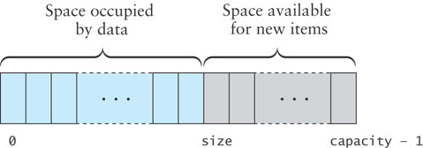
Implementing an ArrayList Class
KWArrayList: a simple implementation of ArrayList
Physical size of array indicated by data field capacity
Number of data items indicated by the data field size

Slide 31
KWArrayList Fields
import java.util.*;
/** This class implements some of the methods of the Java ArrayList class
*/
public class KWArrayList<E> {
// Data fields
/** The default initial capacity */
private static final int INITIAL_CAPACITY = 10;
/** The underlying data array */
private E[] theData;
/** The current size */
private int size = 0;
/** The current capacity */
private int capacity = 0;
}

Slide 32
KWArrayList Constructor
public KWArrayList () {
capacity = INITIAL_CAPACITY;
theData = (E[]) new Object[capacity];
}
This statement allocates storage for an array of type Object and then casts the array object to type E[]
Although this may cause a compiler warning, it's ok

Slide 33
Implementing ArrayList.add(E)
We will implement two add methods
One will append at the end of the list
The other will insert an item at a specified position

Slide 34
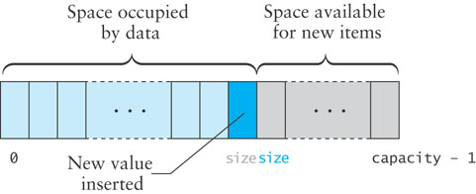
Implementing ArrayList.add(E)(cont.)
If size is less than capacity, then to append a new item
insert the new item at the position indicated by the value of size
increment the value of size
return true to indicate successful insertion

Slide 35
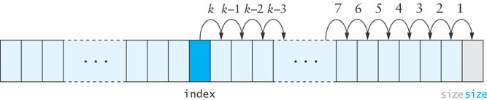
Implementing ArrayList.add(int index,E anEntry)
To insert into the middle of the array, the values at the insertion point are shifted over to make room, beginning at the end of the array and proceeding in the indicated order

Slide 36
Implementing ArrayList.add(index,E)
public void add (int index, E anEntry) {
// check bounds
if (index < 0 || index > size) {
throw new ArrayIndexOutOfBoundsException(index);
}
// Make sure there is room
if (size >= capacity) {
reallocate();
}
// shift data
for (int i = size; i > index; i--) {
theData[i] = theData[i-1];
}
// insert item
theData[index] = anEntry;
size++;
}

Slide 37
set and get Methods
public E get (int index) {
if (index < 0 || index >= size) {
throw new ArrayIndexOutOfBoundsException(index);
}
return theData[index];
}
public E set (int index, E newValue) {
if (index < 0 || index >= size) {
throw new ArrayIndexOutOfBoundsException(index);
}
E oldValue = theData[index];
theData[index] = newValue;
return oldValue;
}

Slide 38
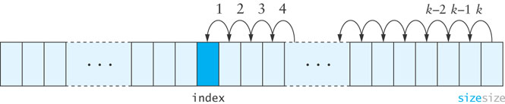
remove Method
When an item is removed, the items that follow it must be moved forward to close the gap
Begin with the item closest to the removed element and proceed in the indicated order

Slide 39
remove Method (cont.)
public E remove (int index) {
if (index < 0 || index >= size) {
throw new ArrayIndexOutOfBoundsException(index);
}
E returnValue = theData[index];
for (int i = index + 1; i < size; i++) {
theData[i-1] = theData[i];
}
size--;
return returnValue;
}

Slide 40
reallocate Method
Create a new array that is twice the size of the current array and then copy the contents of the new array
private void reallocate () {
capacity *= 2;
theData = Arrays.copyOf(theData, capacity);
}

Slide 41
reallocate Method (cont.)
private void reallocate () {
capacity *= 2;
theData = Arrays.copyOf(theData, capacity);
}
The reason for doubling is to spread out the cost of copying; we discuss this further in the next section

Slide 42
KWArrayList as a Collection of Objects
Earlier versions of Java did not support generics; all collections contained only Object elements
To implement KWArrayList this way,
remove the parameter type <E> from the class heading,
replace each reference to data type E by Object
The underlying data array becomes
private Object[] theData;

Slide 43
Vector Class
The Java API java.util contains two very similar classes, Vector and ArrayList
New applications normally use ArrayList rather than Vector as ArrayList is generally more efficient
Vector class is synchronized, which means that multiple threads can access a Vector object without conflict

Slide 44
Algorithm Efficiency and Big-O
Section 2.4

Slide 45
Algorithm Efficiency and Big-O
Getting a precise measure of the performance of an algorithm is difficult
Big-O notation expresses the performance of an algorithm as a function of the number of items to be processed
This permits algorithms to be compared for efficiency
For more than a certain number of data items, some problems cannot be solved by any computer

Slide 46
Linear Growth Rate
If processing time increases in proportion to the number of inputs n, the algorithm grows at a linear rate
public static int search(int[] x, int target) {
for(int i=0; i < x.length; i++) {
if (x[i]==target)
return i;
}
return -1; // target not found
}

Slide 47
Linear Growth Rate
If the target is not present, the for loop will execute x.length times
If the target is present the for loop will execute (on average) (x.length + 1)/2 times
Therefore, the total execution time is directly proportional to x.length
This is described as a growth rate of order n OR
O(n)
If processing time increases in proportion to the number of inputs n, the algorithm grows at a linear rate
public static int search(int[] x, int target) {
for(int i=0; i < x.length; i++) {
if (x[i]==target)
return i;
}
return -1; // target not found
}

Slide 48
n x m Growth Rate
Processing time can be dependent on two different inputs
public static boolean areDifferent(int[] x, int[] y) {
for(int i=0; i < x.length; i++) {
if (search(y, x[i]) != -1)
return false;
}
return true;
}

Slide 49
n x m Growth Rate (cont.)
The for loop will execute x.length times
But it will call search, which will execute y.length times
The total execution time is proportional to (x.length * y.length)
The growth rate has an order of n x m or
O(n x m)
Processing time can be dependent on two different inputs.
public static boolean areDifferent(int[] x, int[] y) {
for(int i=0; i < x.length; i++) {
if (search(y, x[i]) != -1)
return false;
}
return true;
}

Slide 50
Quadratic Growth Rate
If processing time is proportional to the square of the number of inputs n, the algorithm grows at a quadratic rate
public static boolean areUnique(int[] x) {
for(int i=0; i < x.length; i++) {
for(int j=0; j < x.length; j++) {
if (i != j && x[i] == x[j])
return false;
}
}
return true;
}

Slide 51
Quadratic Growth Rate (cont.)
The for loop with i as index will execute x.length times
The for loop with j as index will execute x.length times
The total number of times the inner loop will execute is (x.length)²
The growth rate has an order of n² or
O(n²)
If processing time is proportional to the square of the number of inputs n, the algorithm grows at a quadratic rate
public static boolean areUnique(int[] x) {
for(int i=0; i < x.length; i++) {
for(int j=0; j < x.length; j++) {
if (i != j && x[i] == x[j])
return false;
}
}
return true;
}

Slide 52
Big-O Notation
The O() in the previous examples can be thought of as an abbreviation of "order of magnitude"
A simple way to determine the big-O notation of an algorithm is to look at the loops and to see whether the loops are nested
Assuming a loop body consists only of simple statements,
a single loop is O(n)
a pair of nested loops is O(n²)
a nested pair of loops inside another is O(n³)
and so on . . .

Slide 53
Big-O Notation (cont.)
You must also examine the number of times a loop is executed
for(i=1; i < x.length; i *= 2) {
// Do something with x[i]
}
The loop body will execute k-1 times, with i having the following values: 1, 2, 4, 8, 16, . . ., 2^{k} until 2^{k} is greater than x.length
Since 2^{k-1} = x.length < 2^{k} and log₂2^{k} is k, we know that k-1 = log₂(x.length) < k
Thus we say the loop is O(log n) (in analyzing algorithms, we use logarithms to the base 2)
Logarithmic functions grow slowly as the number of data items n increases

Slide 54
Formal Definition of Big-O
Consider the following program structure:
for (int i = 0; i < n; i++) {
for (int j = 0; j < n; j++) {
Simple Statement
}
}
for (int i = 0; i < n; i++) {
Simple Statement 1
Simple Statement 2
Simple Statement 3
Simple Statement 4
Simple Statement 5
}
Simple Statement 6
Simple Statement 7
...
Simple Statement 30

Slide 55
Formal Definition of Big-O (cont.)
Consider the following program structure:
for (int i = 0; i < n; i++) {
for (int j = 0; j < n; j++) {
Simple Statement
}
}
for (int i = 0; i < n; i++) {
Simple Statement 1
Simple Statement 2
Simple Statement 3
Simple Statement 4
Simple Statement 5
}
Simple Statement 6
Simple Statement 7
...
Simple Statement 30
This nested loop executes a Simple Statement n² times

Slide 56
Formal Definition of Big-O (cont.)
Consider the following program structure:
for (int i = 0; i < n; i++) {
for (int j = 0; j < n; j++) {
Simple Statement
}
}
for (int i = 0; i < n; i++) {
Simple Statement 1
Simple Statement 2
Simple Statement 3
Simple Statement 4
Simple Statement 5
}
Simple Statement 6
Simple Statement 7
...
Simple Statement 30
This loop executes 5 Simple Statements n times (5n)

Slide 57
Formal Definition of Big-O (cont.)
Consider the following program structure:
for (int i = 0; i < n; i++) {
for (int j = 0; j < n; j++) {
Simple Statement
}
}
for (int i = 0; i < n; i++) {
Simple Statement 1
Simple Statement 2
Simple Statement 3
Simple Statement 4
Simple Statement 5
}
Simple Statement 6
Simple Statement 7
...
Simple Statement 30
Finally, 25 Simple Statements are executed

Slide 58
Formal Definition of Big-O (cont.)
Consider the following program structure:
for (int i = 0; i < n; i++) {
for (int j = 0; j < n; j++) {
Simple Statement
}
}
for (int i = 0; i < n; i++) {
Simple Statement 1
Simple Statement 2
Simple Statement 3
Simple Statement 4
Simple Statement 5
}
Simple Statement 6
Simple Statement 7
...
Simple Statement 30
We can conclude that the relationship between processing time and n (the number of date items processed) is:
T(n) = n² + 5n + 25

Slide 59
Formal Definition of Big-O (cont.)
In terms of T(n),
T(n) = O(f(n))
There exist
two constants, n₀ and c, greater than zero, and
a function, f(n),
such that for all n > n₀, cf(n) = T(n)
In other words, as n gets sufficiently large (larger than n₀), there is some constant c for which the processing time will always be less than or equal to cf(n)
cf(n) is an upper bound on performance

Slide 60
Formal Definition of Big-O (cont.)
The growth rate of f(n) will be determined by the fastest growing term, which is the one with the largest exponent
In the example, an algorithm of
O(n² + 5n + 25)
is more simply expressed as
O(n²)
In general, it is safe to ignore all constants and to drop the lower-order terms when determining the order of magnitude

Slide 61
Big-O Example 1
Given T(n) = n² + 5n + 25, show that this is O(n²)
Find constants n₀ and c so that, for all n > n₀, cn² > n² + 5n + 25
Find the point where cn² = n² + 5n + 25
Let n = n₀, and solve for c
c = 1 + 5/ n₀, + 25/ n₀ ²
When n₀ is 5(1 + 5/5 + 25/25), c is 3
So, 3n² > n² + 5n + 25 for all n > 5
Other values of n₀ and c also work

Slide 62
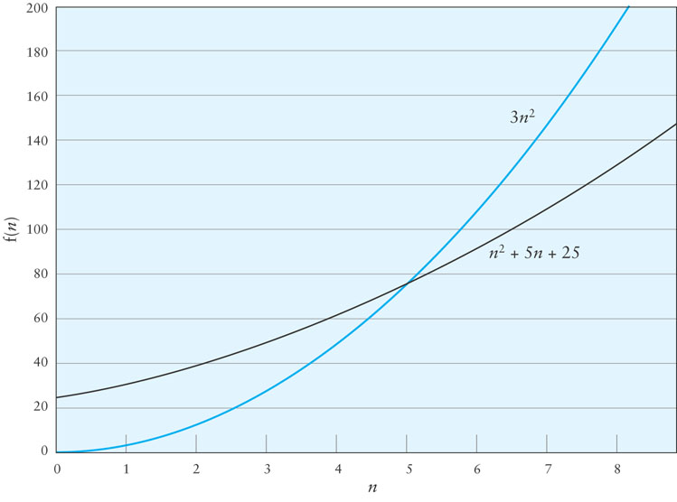
Big-O Example 1 (cont.)

Slide 63
Big-O Example 2
Consider the following loop
for (int i = 0; i < n; i++) {
for (int j = i + 1; j < n; j++) {
3 simple statements
}
}
T(n) = 3(n – 1) + 3 (n – 2) + … + 3
Factoring out the 3,
3(n – 1 + n – 2 + n – 3 + … + 1)
1 + 2 + … + n – 1 = (n x (n-1))/2

Slide 64
Big-O Example 2 (cont.)
Therefore T(n) = 1.5n² – 1.5n
When n = 0, the polynomial has the value 0
For values of n > 1, 1.5n² > 1.5n² – 1.5n
Therefore T(n) is O(n²) when n₀ is 1 and c is 1.5

Slide 65
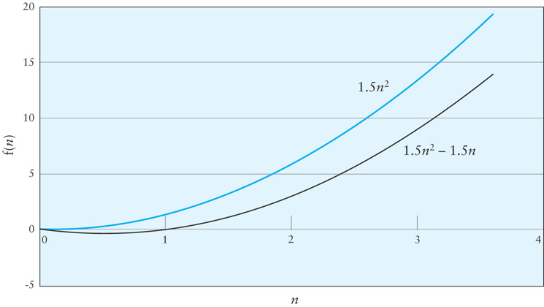
Big-O Example 2 (cont.)

Slide 66
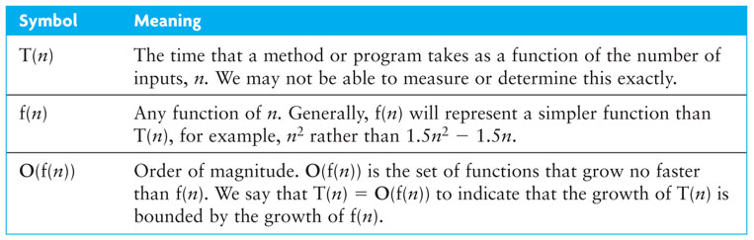
Symbols Used in Quantifying Performance

Slide 67
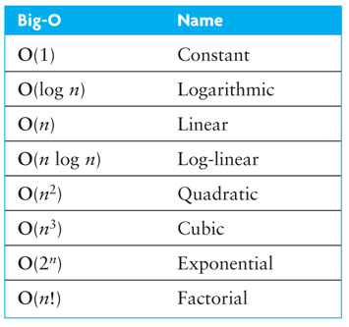
Common Growth Rates

Slide 68
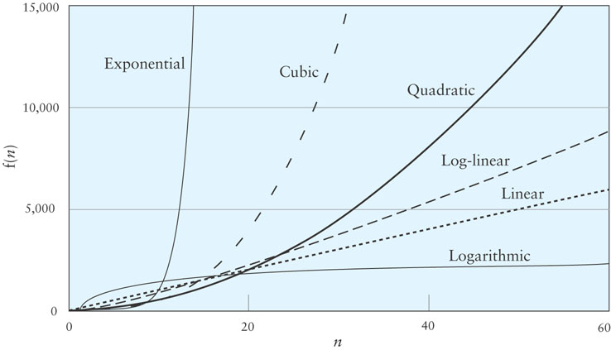
Different Growth Rates

Slide 69
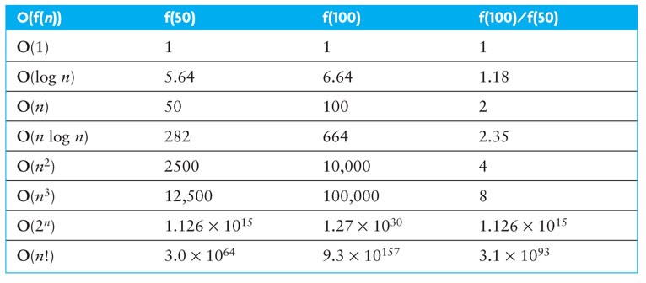
Effects of Different Growth Rates

Slide 70
Algorithms with Exponential and Factorial Growth Rates
Algorithms with exponential and factorial growth rates have an effective practical limit on the size of the problem they can be used to solve
With an O(2^{n}) algorithm, if 100 inputs takes an hour then,
101 inputs will take 2 hours
105 inputs will take 32 hours
114 inputs will take 16,384 hours (almost 2 years!)

Slide 71
Algorithms with Exponential and Factorial Growth Rates (cont.)
Encryption algorithms take advantage of this characteristic
Some cryptographic algorithms can be broken in O(2^{n}) time, where n is the number of bits in the key
A key length of 40 is considered breakable by a modern computer,
but a key length of 100 bits will take a billion-billion (10¹⁸) times longer than a key length of 40

Slide 72
Performance of KWArrayList
The set and get methods execute in constant time: O(1)
Inserting or removing general elements is linear time: O(n)
Adding at the end is (usually) constant time: O(1)
With our reallocation technique the average is O(1)
The worst case is O(n) because of reallocation

Slide 73
Single-Linked Lists
Section 2.5

Slide 74
Single-Linked Lists
A linked list is useful for inserting and removing at arbitrary locations
The ArrayList is limited because its add and remove methods operate in linear (O(n)) time—requiring a loop to shift elements
A linked list can add and remove elements at a known location in O(1) time
In a linked list, instead of an index, each element is linked to the following element

Slide 75
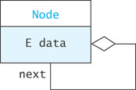
A List Node
A node can contain:
a data item
one or more links
A link is a reference to a list node
In our structure, the node contains a data field named data of type E
and a reference to the next node, named next

Slide 76
List Nodes for Single-Linked Lists
private static class Node<E> {
private E data;
private Node<E> next;
/** Creates a new node with a null next field
@param dataItem The data stored
*/
private Node(E dataItem) {
data = dataItem;
next = null;
}
/** Creates a new node that references another node
@param dataItem The data stored
@param nodeRef The node referenced by new node
*/
private Node(E dataItem, Node<E> nodeRef) {
data = dataItem;
next = nodeRef;
}
}

Slide 77
List Nodes for Single-Linked Lists (cont.)
private static class Node<E> {
private E data;
private Node<E> next;
/** Creates a new node with a null next field
@param dataItem The data stored
*/
private Node(E data) {
data = dataItem;
next = null;
}
/** Creates a new node that references another node
@param dataItem The data stored
@param nodeRef The node referenced by new node
*/
private Node(E dataItem, Node<E> nodeRef) {
data = dataItem;
next = nodeRef;
}
}
The keyword static indicates that the Node<E> class will not reference its outer class
Static inner classes are also called nested classes

Slide 78
List Nodes for Single-Linked Lists (cont.)
private static class Node<E> {
private E data;
private Node<E> next;
/** Creates a new node with a null next field
@param dataItem The data stored
*/
private Node(E dataItem) {
data = dataItem;
next = null;
}
/** Creates a new node that references another node
@param dataItem The data stored
@param nodeRef The node referenced by new node
*/
private Node(E dataItem, Node<E> nodeRef) {
data = dataItem;
next = nodeRef;
}
}
Generally, all details of the Node class should be private. This applies also to the data fields and constructors.

Slide 79
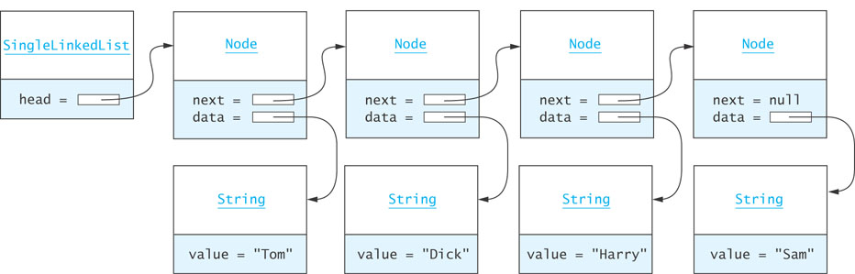
Connecting Nodes

Slide 80
Connecting Nodes (cont.)
Node<String> tom = new Node<String>("Tom");
Node<String> dick = new Node<String>("Dick");
Node<String> harry = new Node<String>("Harry");
Node<String> sam = new Node<String>("Sam");
tom.next = dick;
dick.next = harry;
harry.next = sam;

Slide 81
A Single-Linked List Class
Generally, we do not have individual references to each node.
A SingleLinkedList object has a data field head, the list head, which references the first list node
public class SingleLinkedList<E> {
private Node<E> head = null;
private int size = 0;
...
}

Slide 82
SLList: An Example List
SLList<String>
head =
Node<String>
Node<String>
next =
data = "Tom"
next =
data = "Dick"

Slide 83
Implementing SLList.addFirst(E item)
SLList<String>
Node<String>
Node<String>
head =
next =
data = "Tom"
next =
data = "Dick"
Node<String>
next =
data = "Ann"
The element added to the list

Slide 84
Implementing SLList.addFirst(E item) (cont.)
private void addFirst (E item) {
Node<E> temp = new Node<E>(item, head);
head = temp;
size++;
}
or, more simply ...
private void addFirst (E item) {
head = new Node<E>(item, head);
size++;
}
This works even if head is null

Slide 85
Implementing addAfter(Node<E> node, E item)
SLList<String>
Node<String>
Node<String>
head =
next =
data = "Tom"
next =
data = "Dick"
Node<String>
next =
data = "Ann"
The element added to the list

Slide 86
Implementing addAfter(Node<E> node, E item) (cont.)
private void addAfter (Node<E> node, E item) {
Node<E> temp = new Node<E>(item, node.next);
node.next = temp;
size++;
}
or, more simply ...
private void addAfter (Node<E> node, E item) {
node.next = new Node<E>(item, node.next);
size++;
}
We declare this method private since it should not be called from outside the class. Later we will see how this method is used to implement the public add methods.

Slide 87
Implementing removeAfter(Node<E> node)
temp
SLList<String>
Node<String>
Node<String>
head =
next =
data = "Tom"
next =
data = "Dick"
Node<String>
The Node parameter
next =
data = "Ann"

Slide 88
Implementing removeAfter(Node<E> node) (cont.)
private E removeAfter (Node<E> node) {
Node<E> temp = node.next;
if (temp != null) {
node.next = temp.next;
size--;
return temp.data;
} else {
return null;
}
}

Slide 89
Implementing SLList.removeFirst()
SLList<String>
Node<String>
head =
next =
data = "Dick"
Node<String>
next =
data = "Tom"
temp

Slide 90
Implementing SLList.removeFirst() (cont.)
private E removeFirst () {
Node<E> temp = head;
if (head != null) {
head = head.next;
}
if (temp != null) {
size--;
return temp.data
} else {
return null;
}
}

Slide 91
Traversing a Single-Linked List
SLList<String>
Node<String>
Node<String>
head =
next =
data = "Tom"
next =
data = "Dick"
Do something with nodeRef
Do something with nodeRef
Do something with nodeRef
Node<String>
nodeRef
next =
data = "Ann"
null

Slide 92
Traversing a Single-Linked List (cont.)
toString()can be implemented with a traversal:
public String toString() {
Node<String> nodeRef = head;
StringBuilder result = new StringBuilder();
while (nodeRef != null) {
result.append(nodeRef.data);
if (nodeRef.next != null) {
result.append(" ==> ");
}
nodeRef = nodeRef.next;
}
return result.toString();
}

Slide 93
SLList.getNode(int)
In order to implement methods required by the List interface, we need an additional helper method:
private Node<E> getNode(int index) {
Node<E> node = head;
for (int i=0; i<index && node != null; i++) {
node = node.next;
}
return node;
}

Slide 94
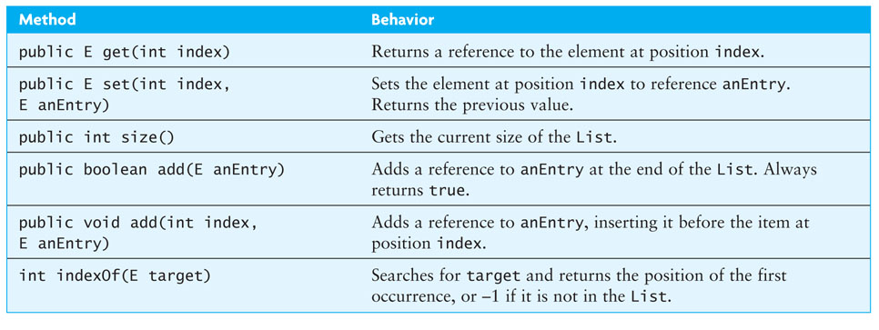
Completing the SingleLinkedList Class

Slide 95
public E get(int index)
public E get (int index) {
if (index < 0 || index >= size) {
throw new IndexOutOfBoundsException(Integer.toString(index));
}
Node<E> node = getNode(index);
return node.data;
}

Slide 96
public E set(int index, E newValue)
public E set (int index, E anEntry) {
if (index < 0 || index >= size) {
throw new IndexOutOfBoundsException(Integer.toString(index));
}
Node<E> node = getNode(index);
E result = node.data;
node.data = anEntry;
return result;
}

Slide 97
public void add(int index, E item)
public void add (int index, E item) {
if (index < 0 || index > size) {
throw new
IndexOutOfBoundsException(Integer.toString(index));
}
if (index == 0) {
addFirst(item);
} else {
Node<E> node = getNode(index-1);
addAfter(node, item);
}
}

Slide 98
public boolean add(E item)
To add an item to the end of the list
public boolean add (E item) {
add(size, item);
return true;
}

Slide 99
Double-Linked Lists and Circular Lists
Section 2.6

Slide 100
Double-Linked Lists
Limitations of a singly-linked list include:
Insertion at the front is O(1); insertion at other positions is O(n)
Insertion is convenient only after a referenced node
Removing a node requires a reference to the previous node
We can traverse the list only in the forward direction
We can overcome these limitations:
Add a reference in each node to the previous node, creating a double-linked list

Slide 101
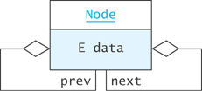
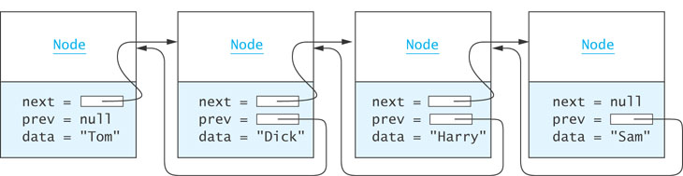
Double-Linked Lists (cont.)

Slide 102
Node Class
private static class Node<E> {
private E data;
private Node<E> next = null;
private Node<E> prev = null;
private Node(E dataItem) {
data = dataItem;
}
}

Slide 103
Inserting into a Double-Linked List
from predecessor
sam
Node
Node
next =
= prev
data = "Harry"
next = null
= prev
data = "Sam"
to predecessor
Node<E> sharon = new Node<E>("Sharon");
sharon.next = sam;
sharon.prev = sam.prev;
sam.prev.next = sharon;
sam.prev = sharon
sharon
Node
next =
= prev
data = "Sharon"

Slide 104
Removing from a Double-Linked List
harry
Node
Node
next =
= prev
data = "Dick"
next =
= prev
data = "Sharon"
Node
harry.prev.next = harry.next
harry.next.prev = harry.prev
next =
= prev
data = "Harry"

Slide 105

A Double-Linked List Class
So far we have worked only with internal nodes
As with the single-linked class, it is best to access the internal nodes with a double-linked list object
A double-linked list object has data fields:
head (a reference to the first list Node)
tail (a reference to the last list Node)
size
Insertion at either end is O(1); insertion elsewhere is still O(n)

Slide 106
Circular Lists
Circular double-linked list:
Link last node to the first node, and
Link first node to the last node
We can also build singly-linked circular lists:
Traverse in forward direction only
Advantages:
Continue to traverse even after passing the first or last node
Visit all elements from any starting point
Never fall off the end of a list
Disadvantage: Code must avoid an infinite loop!

Slide 107
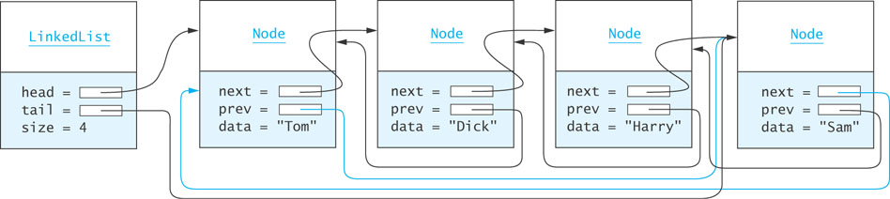
Circular Lists (cont.)

Slide 108
The LinkedList Class and the Iterator, ListIterator, and Iterable Interfaces
Section 2.7

Slide 109
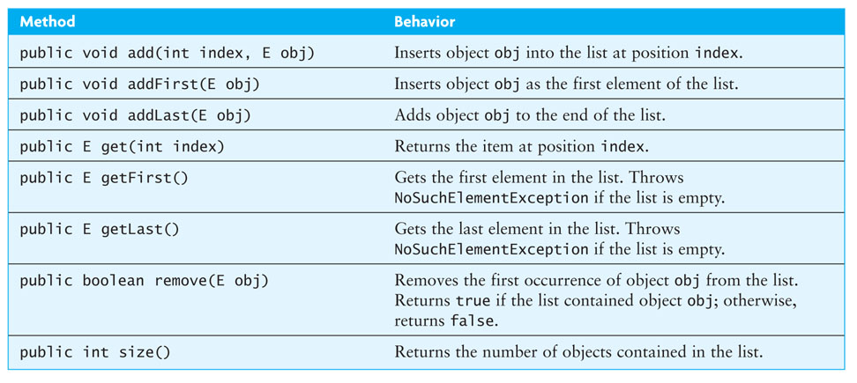
The LinkedList Class

Slide 110
The Iterator
An iterator can be viewed as a moving place marker that keeps track of the current position in a particular linked list
An Iterator object for a list starts at the first node
The programmer can move the Iterator by calling its next method
The Iterator stays on its current list item until it is needed
An Iterator traverses in O(n) while a list traversal using get() calls in a linked list is O(n²)

Slide 111
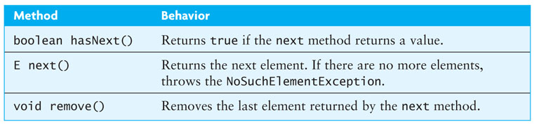
Iterator Interface
The Iterator interface is defined in java.util
The List interface declares the method iterator which returns an Iterator object that iterates over the elements of that list

Slide 112
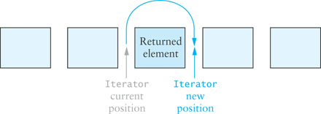
Iterator Interface (cont.)
An Iterator is conceptually between elements; it does not refer to a particular object at any given time

Slide 113
Iterator Interface (cont.)
In the following loop, we process all items in List<Integer> through an Iterator
Iterator<Integer> iter = aList.iterator();
while (iter.hasNext()) {
int value = iter.next();
// Do something with value
...
}

Slide 114
Iterators and Removing Elements
You can use the Iterator remove()method to remove items from a list as you access them
remove() deletes the most recent element returned
You must call next()before each remove(); otherwise, an IllegalStateException will be thrown
LinkedList.remove vs. Iterator.remove:
LinkedList.remove must walk down the list each time, then remove, so in general it is O(n²)
Iterator.remove removes items without starting over at the beginning, so in general it is O(n)

Slide 115
Iterators and Removing Elements (cont.)
To remove all elements from a list of type Integer that are divisible by a particular value:
public static void removeDivisibleBy(LinkedList<Integer> aList, int div) {
Iterator<Integer> iter = aList.iterator();
while (iter.hasNext()) {
int nextInt = iter.next();
if (nextInt % div == 0) {
iter.remove();
}
}
}

Slide 116
ListIterator Interface
Iterator limitations
Traverses List only in the forward direction
Provides a remove method, but no add method
You must advance the Iterator using your own loop if you do not start from the beginning of the list
ListIterator extends Iterator, overcoming these limitations

Slide 117
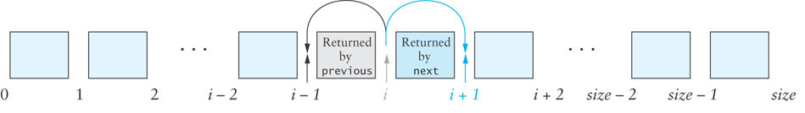
ListIterator Interface (cont.)
As with Iterator, ListIterator is conceptually positioned between elements of the list
ListIterator positions are assigned an index from 0 to size

Slide 118
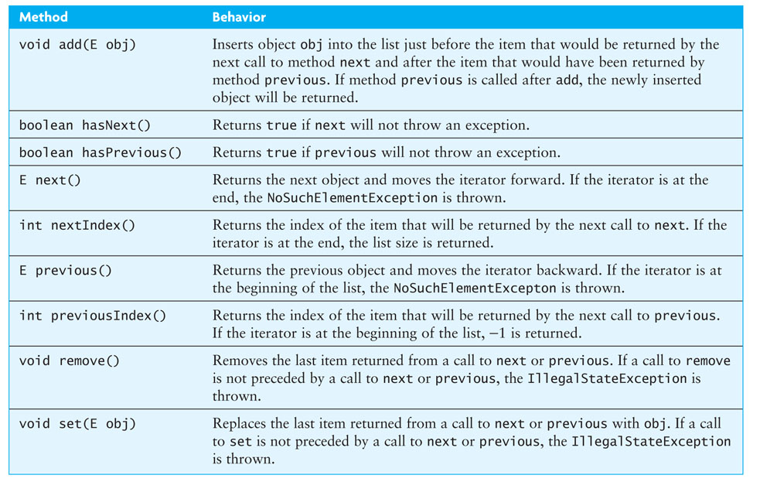
ListIterator Interface (cont.)

Slide 119
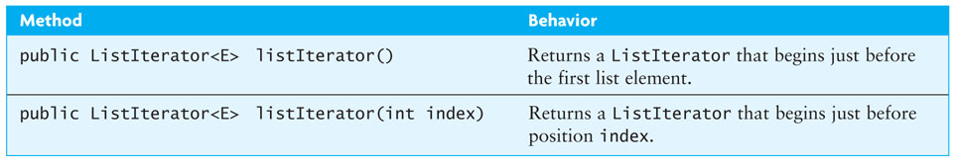
ListIterator Interface (cont.)

Slide 120
Comparison of Iterator and ListIterator
ListIterator is a subinterface of Iterator
Classes that implement ListIterator must provide the features of both
Iterator:
Requires fewer methods
Can iterate over more general data structures
Iterator is required by the Collection interface
ListIterator is required only by the List interface

Slide 121
Conversion Between ListIterator and an Index
ListIterator:
nextIndex()returns the index of item to be returned by next()
previousIndex() returns the index of item to be returned by previous()
LinkedList has method listIterator(int index)
Returns a ListIterator positioned so next()will return the item at position index

Slide 122
Conversion Between ListIterator and an Index (cont.)
The listIterator (int index) method creates a new ListIterator that starts at the beginning, and walks down the list to the desired position – generally an O(n) operation

Slide 123
Enhanced for Statement
Java 5.0 introduced an enhanced for statement
The enhanced for statement creates an Iterator object and implicitly calls its hasNext and next methods
Other Iterator methods, such as remove, are not available

Slide 124
Enhanced for Statement (cont.)
The following code counts the number of times target occurs in myList (type LinkedList<String>)
count = 0;
for (String nextStr : myList) {
if (target.equals(nextStr)) {
count++;
}
}

Slide 125
Enhanced for Statement (cont.)
In list myList of type LinkedList<Integer>, each Integer object is automatically unboxed:
sum = 0;
for (int nextInt : myList) {
sum += nextInt;
}

Slide 126
Enhanced for Statement (cont.)
The enhanced for statement also can be used with arrays, in this case, chars or type char[]
for (char nextCh : chars) {
System.out.println(nextCh);
}

Slide 127
Iterable Interface
Each class that implements the List interface must provide an iterator method
The Collection interface extends the Iterable interface
All classes that implement the List interface (a subinterface of Collection) must provide an iterator method
Allows use of the Java 5.0 for-each loop
public interface Iterable<E> {
/** returns an iterator over the elements in this collection. */
Iterator<E> iterator();
}

Slide 128
Implementation of a Double-Linked List Class
Section 2.8

Slide 129
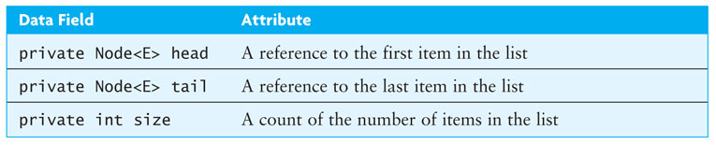
KWLinkedList
We will define a KWLinkedList class which implements some of the methods of the List interface
The KWLinkedList class is for demonstration purposes only; Java provides a standard LinkedList class in java.util which you should use in your programs

Slide 130
KWLinkedList (cont.)
import java.util.*;
/** Class KWLinkedList implements a double linked list and
* a ListIterator. */
public class KWLinkedList <E> {
// Data Fields
private Node <E> head = null;
private Node <E> tail = null;
private int size = 0;
. . .

Slide 131
Add Method
Obtain a reference, nodeRef, to the node at position index
Insert a new Node containing obj before the node referenced by nodeRef
To use a ListIterator object to implement add:
Obtain an iterator that is positioned just before the Node at position index
Insert a new Node containing obj before the Node currently referenced by this iterator
/** Add an item at the specified index.
@param index The index at which the object is to be inserted
@param obj The object to be inserted
@throws IndexOutOfBoundsException if the index is out of range (i < 0 || i > size())
*/
public void add(int index, E obj) {
listIterator(index).add(obj);
}
It is not necessary to declare a local ListIterator; the method call listIterator returns an anonymous listIterator object

Slide 132
Get Method
Obtain a reference, nodeRef, to the node at position index
Return the contents of the Node referenced by nodeRef
/** Get the element at position index.
@param index Position of item to be retrieved
@return The item at index
*/
public E get(int index) {
return listIterator(index).next();
}

Slide 133
Other Add and Get Methods
public void addFirst(E item) {
add(0, item);
}
public void addLast(E item) {
add(size, item);
}
public E getFirst() {
return head.data;
}
public E getLast() {
return tail.data;
}

Slide 134
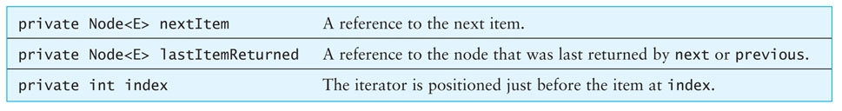
Implementing the ListIterator Interface
KWListIter is an inner class of KWLinkedList which implements the ListIterator interface

Slide 135
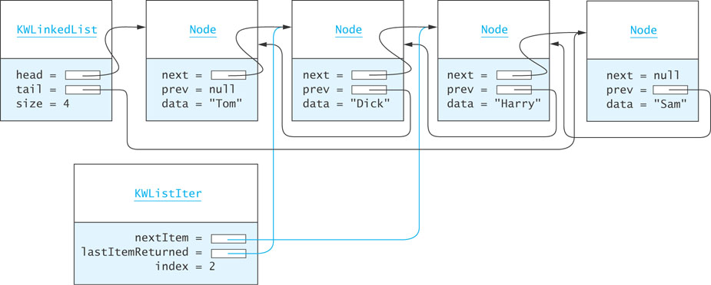
Implementing the ListIterator Interface (cont.)

Slide 136
Implementing the ListIterator Interface (cont.)
private class KWListIter implements ListIterator<E> {
private Node <E> nextItem;
private Node <E> lastItemReturned;
private int index = 0;
...

Slide 137
Constructor
public KWListIter(int i) {
// Validate i parameter.
if (i < 0 || i > size) {
throw new IndexOutOfBoundsException("Invalid index " + i);
}
lastItemReturned = null; // No item returned yet.
// Special case of last item
if (i == size) {
index = size;
nextItem = null;
}
else { // Start at the beginning
nextItem = head;
for (index = 0; index < i; index++) {
nextItem = nextItem.next;
}
}
}

Slide 138
The hasNext()Method
tests to see if nextItem is null
public boolean hasnext() {
return nextItem != null;
}

Slide 139
Advancing the Iterator
KWLinkedList
Node
Node
Node
head
tail
size 3
next
prev null
data "Tom"
next
prev
next
prev
data "Sam"
data "Harry"
KWListIter
public E next() {
if (!hasNext()) {
throw new NoSuchElementException();
}
lastItemReturned = nextItem;
nextItem = nextItem.next;
index++;
return lastItemReturned.data;
}
nextItem
lastItemReturned
index 1
2

Slide 140
Previous Methods
public boolean hasPrevious() {
return (nextItem == null && size != 0) || nextItem.prev != null;
}
public E previous() {
if (!hasPrevious()) {
throw new NoSuchElementException();
}
if (nextItem == null) { // Iterator past the last element
nextItem = tail;
}
else {
nextItem = nextItem.prev;
}
lastItemReturned = nextItem;
index--;
return lastItemReturned.data;
}

Slide 141
The Add Method
When adding, there are four cases to address:
Add to an empty list
Add to the head of the list
Add to the tail of the list
Add to the middle of the list

Slide 142
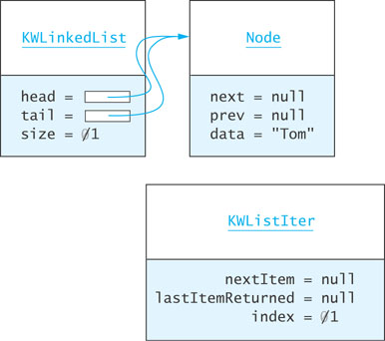
Adding to an Empty List
(after insertion)
if (head == null) {
head = new Node<E>(obj);
tail = head;
}
...
size++

Slide 143
Adding to the Head of the List
KWListIter
nextItem = lastItemReturned = null
index = 0
1
Node
Node
Node
next =
null = prev
data = "Tom"
next =
= prev
data = "Harry"
next = null
= prev
data = "Sam"
KWLinkedList
head = null
tail = null
size = 3
4
if (nextItem == head) {
Node<E> newNode = new Node<E>(obj);
newNode.next = nextItem;
nextItem.prev = newNode;
head = newNode;
}
...
size++;
index++;
Node
next = null
null = prev
data = "Ann"
newNode

Slide 144
Adding to the Tail of the List
KWListIter
nextItem = null lastItemReturned = null
index = 2
3
Node
Node
Node
next =
prev = null
data = "Tom"
next =
= prev
data = "Ann"
next = null
= prev
data = "Sam"
KWLinkedList
head = null
tail = null
size = 3
4
if (nextItem == null) {
Node<E> newNode = new Node<E>(obj);
tail.next = newNode;
newNode.prev = tail;
tail = newNode
}
...
size++;
index++;
Node
next = null
null = prev
data = "Bob"
newNode

Slide 145
Adding to the Middle of the List
KWListIter
nextItem = null lastItemReturned = null
index = 1
2
Node
Node
Node
next =
prev = null
data = "Tom"
next =
= prev
data = "Ann"
next = null
= prev
data = "Sam"
KWLinkedList
head = null
tail = null
size = 3
4
Node
else {
Node<E> newNode = new Node<E>(obj);
newNode.prev = nextItem.prev;
nextItem.prev.next = newNode;
newNode.next = nextItem;
nextItem.prev = newNode;
}
...
size++;
index++;
next = null
null = prev
data = "Bob"
newNode

Slide 146
Inner Classes: Static and Nonstatic
KWLinkedList contains two inner classes:
Node<E> is declared static: there is no need for it to access the data fields of its parent class, KWLinkedList
KWListIter cannot be declared static because its methods access and modify data fields of KWLinkedList’s parent object which created it
An inner class which is not static contains an implicit reference to its parent object and can reference the fields of its parent object
Since its parent class is already defined with the parament <E>, KWListIter cannot be declared as KWListIter<E>; if it were, an incompatible types syntax error would occur

Slide 147
The Collections Framework Design
Section 2.9

Slide 148
The Collection Interface
Specifies a subset of methods in the List interface, specifically excluding
add(int, E)
get(int)
remove(int)
set(int, E)
but including
add(E)
remove(Object)
the iterator method

Slide 149
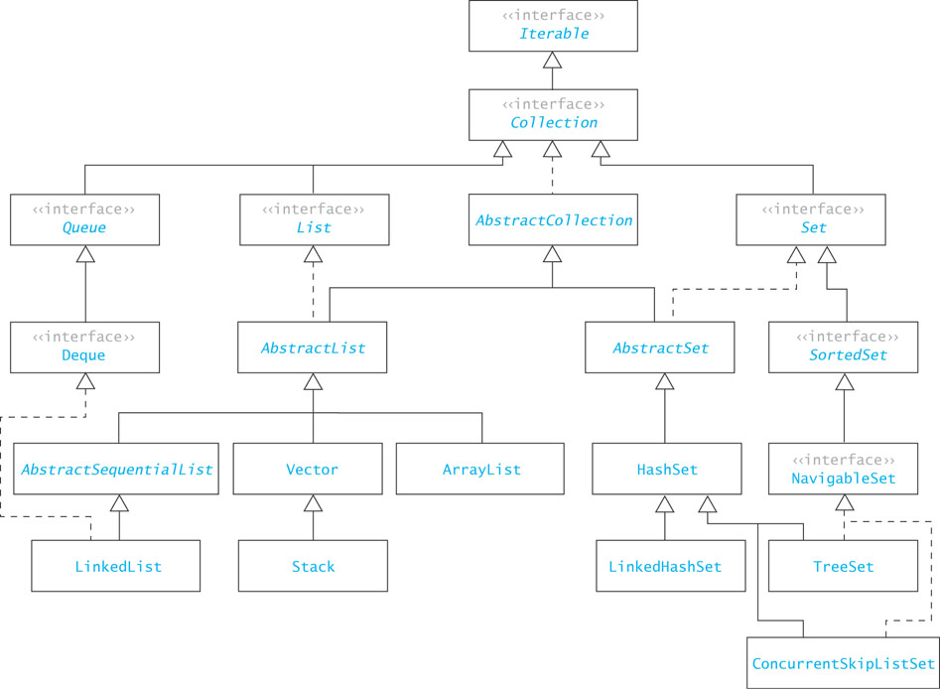
The Collection Framework

Slide 150
Common Features of Collections
Collections
grow as needed
hold references to objects
have at least two constructors: one to create an empty collection and one to make a copy of another collection

Slide 151
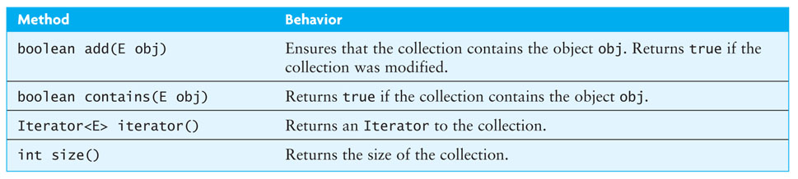
Common Features of Collections (cont.)
In a general Collection the order of elements is not specified
For collections implementing the List interface, the order of the elements is determined by the index

Slide 152
Common Features of Collections (cont.)
In a general Collection, the position where an object is inserted is not specified
In ArrayList and LinkedList, add(E) always inserts at the end and always returns true

Slide 153
AbstractCollection, AbstractList, and AbstractSequentialList
The Java API includes several "helper" abstract classes to help build implementations of their corresponding interfaces
By providing implementations for interface methods not used, the helper classes require the programmer to extend the AbstractCollection class and implement only the desired methods

Slide 154
Implementing a Subclass of Collection<E>
Extend AbstractCollection<E>, which implements most operations
You need to implement only:
add(E)
size()
iterator()
an inner class that implements Iterator<E>

Slide 155
Implementing a Subclass of List<E>
Extend AbstractList<E>
You need to implement only:
add(int, E)
get(int)
remove(int)
set(int, E)
size()
AbstractList implements Iterator<E> using the index

Slide 156
AbstractCollection, AbstractList, and AbstractSequentialList
Another more complete way to declare KWArrayList is:
public class KWArrayList<E> extends AbstractList<E> implements List<E>
Another more complete, way to declare KWLinkedLinkedList is:
public class KWLinkedList<E> extends AbstractSequentialList<E> implements List<E>

Slide 157
List and RandomAccess Interfaces
Accessing a LinkedList using an index requires an O(n) traversal of the list until the index is located
The RandomAccess interface is applied to list implementations in which indexed operations are efficient (e.g. ArrayList)
An algorithm can test to see if a parameter of type List is also of type RandomAccess and, if not, take appropriate measures to optimize indexed operations

Slide 158
Application of the LinkedList Class
Section 2.10

Slide 159
An Application: Ordered Lists
We want to maintain a list of names in alphabetical order at all times
Approach
Develop an OrderedList class (which can be used for other applications)
Implement a Comparable interface by providing a compareTo(E) method
Use a LinkedList class as a component of the OrderedList
if OrderedList extended LinkedList, the user could use LinkedList's add methods to add an element out of order

Slide 160
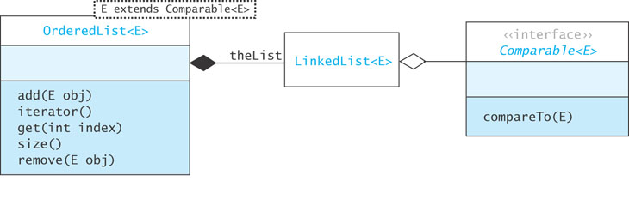
Class Diagram for OrderedList

Slide 161
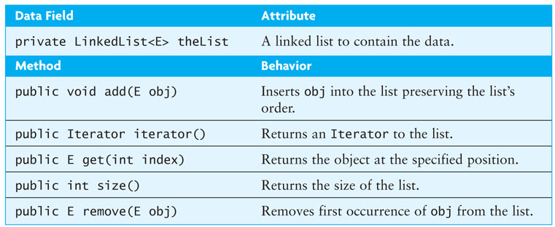
Design

Slide 162
Inserting into an OrderedList
Strategy for inserting new element e:
Find first item > e
Insert e before that item
Refined with an iterator:
Create ListIterator that starts at the beginning of the list
While the ListIterator is not at the end of the list and e >= the next item
Advance the ListIterator
Insert e before the current ListIterator position

Slide 163
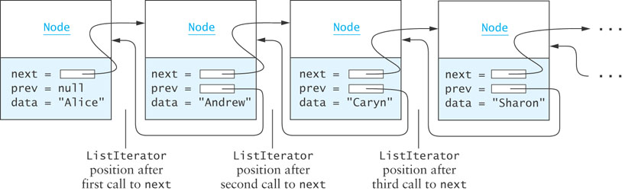
Inserting Diagrammed

Slide 164
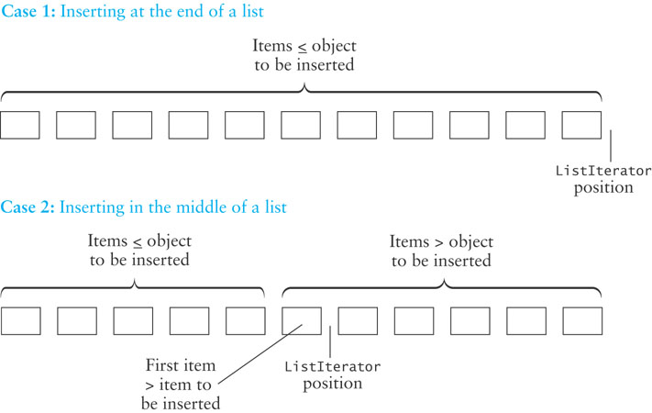
Inserting Diagrammed (cont.)

Slide 165
OrderedList.add
public void add (E e) {
ListIterator<E> iter = theList.listIterator();
while (iter.hasNext()) {
if (e.compareTo(iter.next()) < 0) {
// found element > new one
iter.previous(); // back up by one
iter.add(e); // add new one
return; // done
}
}
iter.add(e); // will add at end
}

Slide 166
Using Delegation to Implement the Other Methods
public E get (int index) {
return theList.get(index);
}
public int size () {
return theList.size();
}
public E remove (E e) {
return theList.remove(e);
}
// returns an iterator positioned before the first element
public Iterator iterator() {
return theList.iterator();
}

